Slide 1

Edu-Tracker
System for Tracking Educational Progress in Real-Time

Slide 2
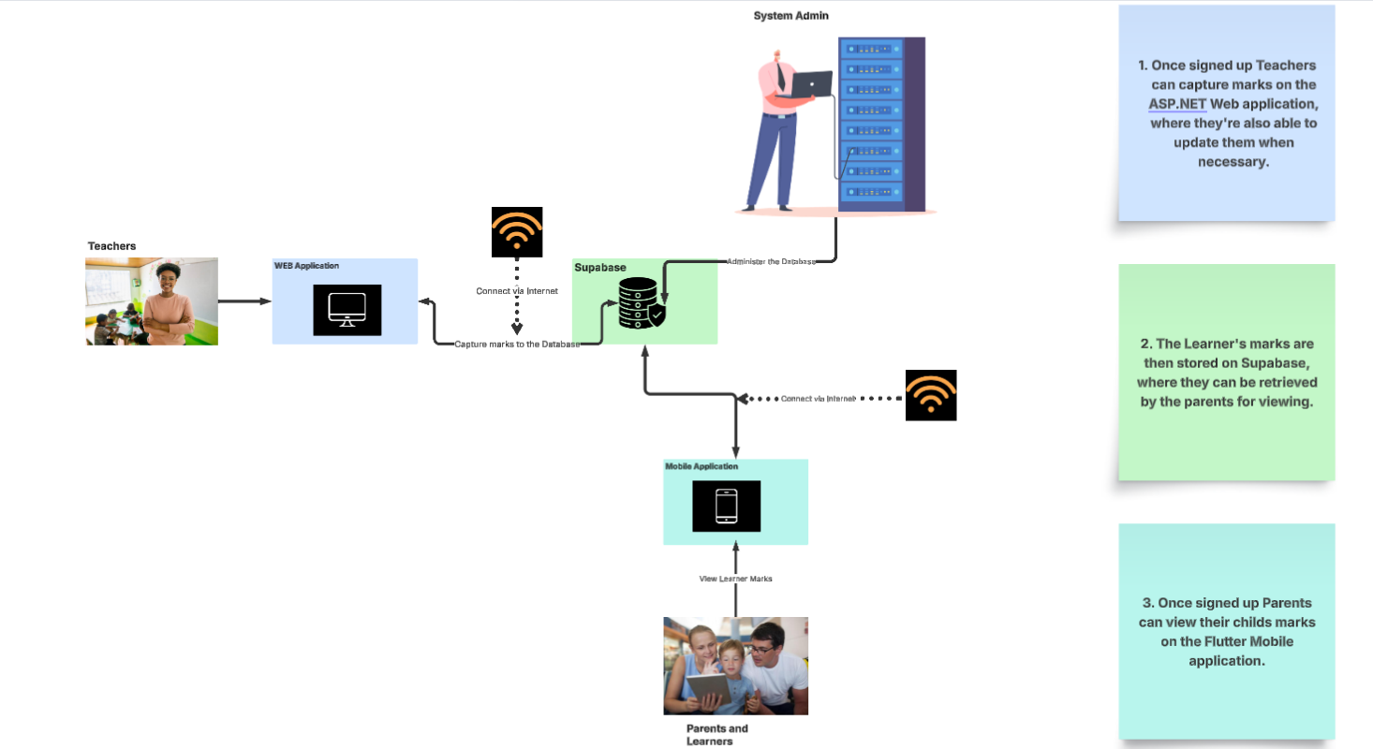
System Architecture Design
System Architecture

Slide 3
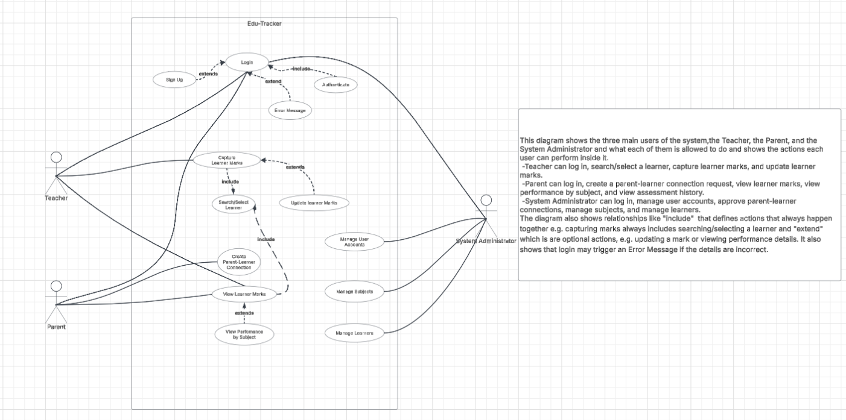
Use case diagram
Use Case Diagram

Slide 4
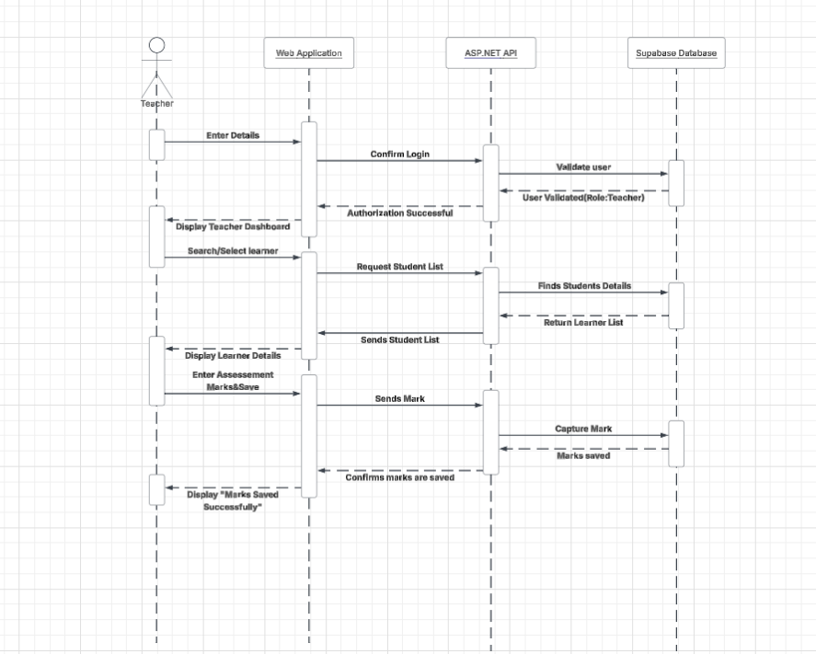
Teacher Sequence Diagram
Teacher Sequence Diagram

Slide 5
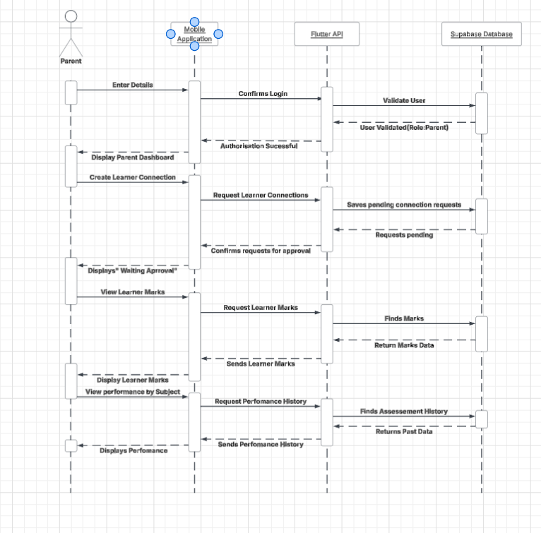
Parent Sequence Diagram
Parent Sequence Diagram

Slide 6
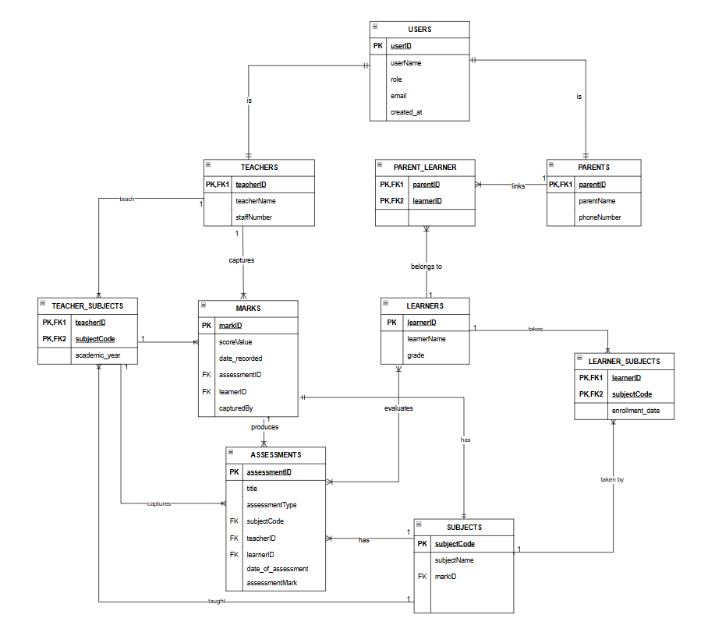
Entity Relationship Diagram
Entity Relationship Diagram

Slide 7
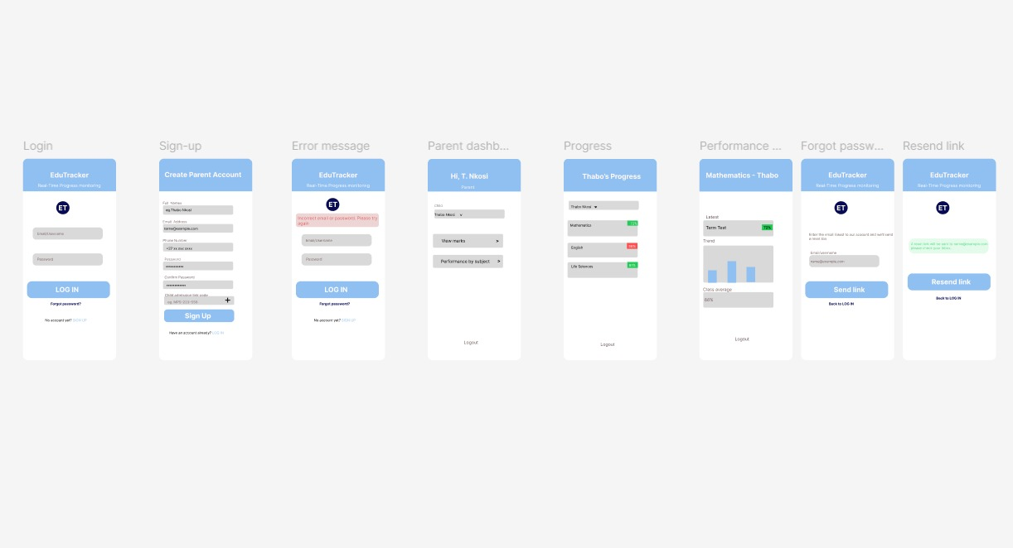
Parent
Interface
(Mobile App Interface)
Mobile App Interface

Slide 8
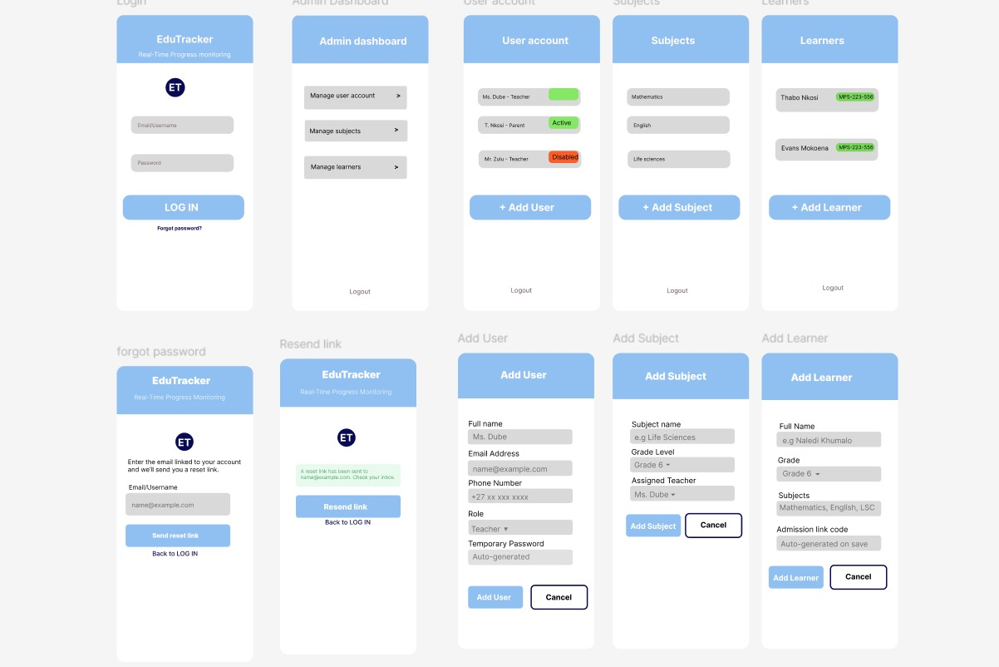
System Admin
Interface
(Web App Interface)
Web App Interface

Slide 9
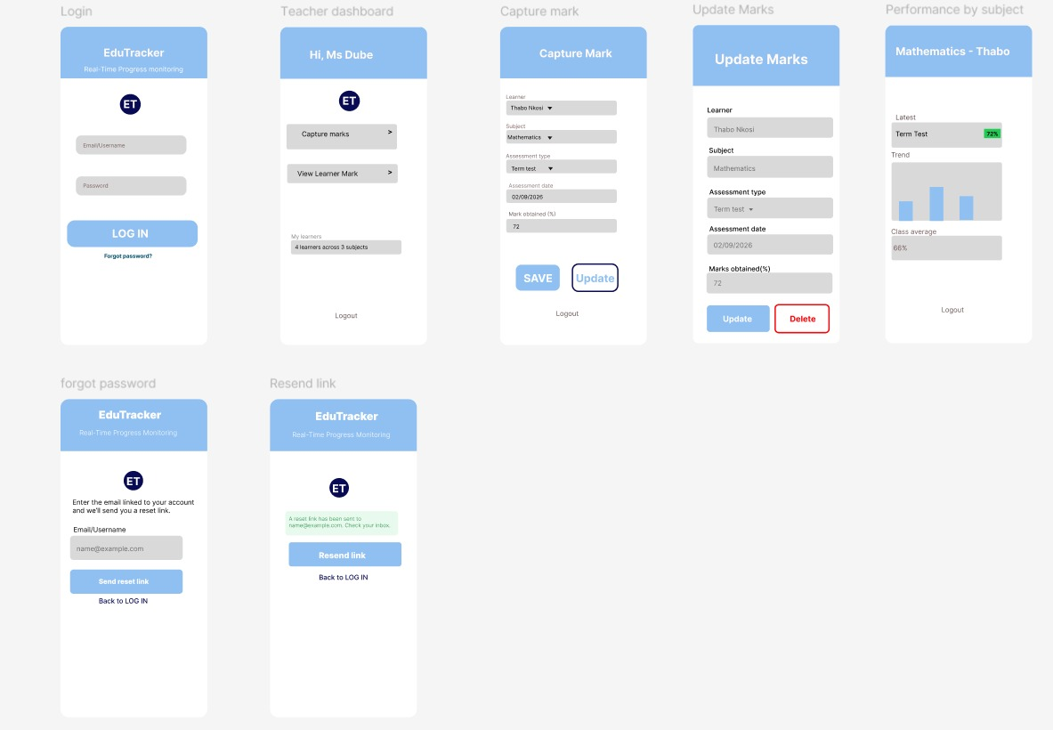
Teacher Interface
(Web App Interface)
Web App Interface

